Slide 1
Ford-Fulkerson Algorithm
CS 330 Intro to the Design and Analysis of Algorithms
Lecture note
Sajedul Talukder

Slide 2
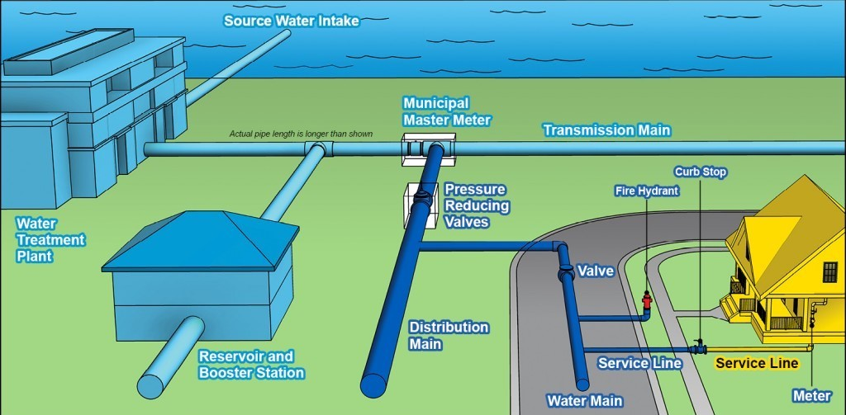
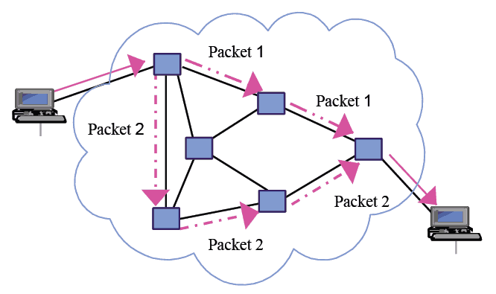
Network Flow Problem
A type of network optimization problem
Arise in many different contexts:
Networks: water supply network. Routing - send as many packets as possible on a given network
Transportation: sending as many trucks as possible, where roads have limits on the number of trucks per unit time
Bridges: destroying (?!) some bridges to disconnect s from t, while minimizing the cost of destroying the bridges

Slide 3
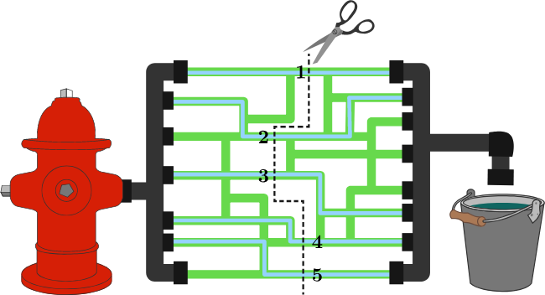
Maximum Flow Problem
Given a graph which represents a flow network where every edge has a capacity. Also given two vertices source ‘s’ and sink ‘t’ in the graph, find the maximum possible flow from s to t with following constraints:
a) Flow on an edge doesn’t exceed the given capacity of the edge.
b) Incoming flow is equal to outgoing flow for every vertex except s and t.

Slide 4
Alternate Formulation: Minimum Cut
We want to remove some edges from the graph such that after removing the edges, there is no path from s to t
◮ The cost of removing e is equal to its capacity c(e)
◮ The minimum cut problem is to find a cut with minimum total cost
◮ Theorem: (maximum flow) = (minimum cut)

Slide 5
Residual Graph
Residual Graph of a flow network is a graph which indicates additional possible flow. If there is a path from source to sink in residual graph, then it is possible to add flow.
Every edge of a residual graph has a value called residual capacity which is equal to original capacity of the edge minus current flow.
Augmenting Path: a simple path of positive capacity from a source to a sink in the residual graph.
flow
capacity
Residual capacity = capacity - flow

Slide 6
Ford-Fulkerson Algorithm
Steps:
While a valid augmenting path exists
Find an augmenting path
Compute the bottleneck capacity
Augment each edge and the total flow
◮ A simple and practical max-flow algorithm
◮ Main idea: find valid flow paths until there is none left, and add them up
◮ Can flow through back edges if flow is not zero

Slide 7
Back Edges
Back edges are the edges on which you can decrease the flow to find new paths which can potentially lead to a higher flow than the current value.
It solves a problem when we might have chosen a wrong path - so we try to refund the current flow.
Sending flow along a back edge essentially means removing flow along that path and pushing the difference along other paths.
◮ Why do we need to do this?
Sending flow to opposite directions is equivalent to canceling/refunding flow
We can use this back edge making a
reverse flow up to 3

Slide 8
Ford-Fulkerson Algorithm
1. You can only go Forward (in the correct direction of a path) if the path has FLOW TO ADD
e.g., 8/10 still has 2 more to add so you can use it but 4/4 is capped.
2. You can only go Backward (in the opposite direction of a path) if the path has FLOW TO GIVE
e.g., 6/8 has 6 to give but you can't go backwards on 0/4 because it has 0 flow to subtract.

Slide 9
Ford-Fulkerson Algorithm - Example
Augmenting Path | Bottleneck Capacity
0/4
A
0/10
B
0/10
0/8
S
0/2
0/6
T
0/10
0/10
D
C
0/9

Slide 10
Ford-Fulkerson Algorithm - Example
Augmenting Path | Bottleneck Capacity
S->A->D->T | 8
0/4
A
8/10
B
0/10
8/8
S
0/2
0/6
T
0/10
8/10
D
C
0/9

Slide 11
Ford-Fulkerson Algorithm - Example
Augmenting Path | Bottleneck Capacity
S->A->D->T | 8
S->C->D->T | 2
0/4
A
8/10
B
0/10
8/8
S
0/2
0/6
T
2/10
10/10
D
C
2/9

Slide 12
Ford-Fulkerson Algorithm - Example
Augmenting Path | Bottleneck Capacity
S->A->D->T | 8
S->C->D->T | 2
S->C->D->A->B->T | 4
4/4
A
8/10
B
4/10
4/8
S
0/2
0/6
T
6/10
10/10
D
C
6/9
Can reverse augment if back edge not 0

Slide 13
Ford-Fulkerson Algorithm - Example
Augmenting Path | Bottleneck Capacity
S->A->D->T | 8
S->C->D->T | 2
S->C->D->A->B->T | 4
S->A->D->B->T | 2
4/4
A
10/10
B
6/10
6/8
S
0/2
2/6
T
6/10
10/10
D
C
6/9

Slide 14
Ford-Fulkerson Algorithm - Example
Augmenting Path | Bottleneck Capacity
S->A->D->T | 8
S->C->D->T | 2
S->C->D->A->B->T | 4
S->A->D->B->T | 2
S->C->D->B->T | 3
4/4
A
10/10
B
9/10
6/8
S
0/2
5/6
T
9/10
10/10
D
C
9/9

Slide 15
Ford-Fulkerson Algorithm - Example
Augmenting Path | Bottleneck Capacity
S->A->D->T | 8
S->C->D->T | 2
S->C->D->A->B->T | 4
S->A->D->B->T | 2
S->C->D->B->T | 3
4/4
A
10/10
B
9/10
6/8
S
0/2
5/6
T
9/10
10/10
D
C
9/9
No more augmenting path!
Maximum total flow: 9 + 10 = 19

Slide 16
Ford-Fulkerson Algorithm
Ford-Fulkerson (G)
Input: A digraph G, weights c: E(G) → R₊ and a vertex s, t∈ V(G).
Output: Maximum possible flow from s to t in graph G.
// G = (V,E) is a weighted directed graph; edge weights are non-negative
1) Start with initial flow as 0.
2) While there is an augmenting path from source to sink.
Do add this path-flow to flow and augment each edge and the total flow
3) Return flow.

Slide 17
Ford-Fulkerson Algorithm Complexity
1) Start with initial flow as 0.
2) While there is an augmenting path from source to sink.
Do add this path-flow to flow.
3) Return flow.
We run a loop while there is an augmenting path
Using DFS, finding an augmenting path takes Θ(E) time
In worst case, we may add only 1 unit of flow through the path
Overall time complexity of the above algorithm is O(max_flow * E)

